Slide 1


Slide 2

TEAM MEMBERS
Aantariksha (L)
Kalyani Bajpai
Kalika Awasthi
Luv Agarwal

Slide 3
INTRODUCTION
Our website comprises of several amazing features which can be utilised by the hostelers and that will help them to make their day-to-day activities easy. We as a team together has developed a fully responsive web application that manages all day to day task of a hosteler such as ordering food, laundry, stationary delivery and many more such things.

Slide 4
OBJECTIVE
Our team is responsible for leading the project planning and execution. Our objective is to achieve our strategic goal in a systematic and a controlled manner. Apart from it, it is to provide a comforting environment for students who live in hostel, to avoid disturbance during their studies.

Slide 5
MOTIVATION

Slide 6
TECHNOLOGY USED
In this project, we will use :
HTML (Hypertext Markup Language)
CSS (Cascading Style Sheet)
Mongo DB

Slide 7
DIAGRAM
LOGIN
DASHBORAD
RESPOND

Slide 8
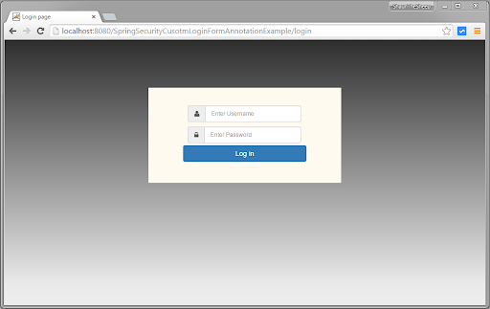

Slide 9
LIMITATION

Slide 10
REFERENCE

